Slide 1
A Thomas Ware
Capstone Project.
Solutions Calculator Club product development

Slide 2
Solutions Calculator Club Product Development
Project Charter
Scope:
Tasked with developing an educational tool to show how a Computational System and Subsystems processes inputs and outputs.
Resources:
A research grant for a development budget of $20,000.
The project research phase time frame of 4 months and an implementation phase time frame was 4 months.
Stakeholders:
Solutions calculator Club are the investors
Thomas Ware is the project developer
Trevor Murray consultant
UFV potential client
Ben Eater 8-bit computer kit Supplier
Risks and assessments:
Scope of the project for a single person, supply chain issues like chip shortages or obsolete components and shipping time if replacements are required. Limitations of the ALU and memory size of registers.
Gantt Chart
Notes:
What is a computational System and what subsystems might it have?
What Is a CPU?
How does an ALU work?
How to convert Binary outputs to Human readable Decimal Display?

Slide 3
Solutions Calculator Club Product Development
CMNS-125 Research:
History and Innovations of the Calculator

Slide 4

History and Innovations of the Calculator
The Abacus
Binary
Weighed Sum
Register
The first calculating device known was the Abacus. Invented in China around the 2nd century B.C. However, Abacus-like devices are first attested from ancient Mesopotamia around 2700 B.C.

Slide 5
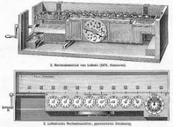
History and Innovations of the Calculator
Step Reckoner
Gottfried Wilhelm Leibniz
(1671) . Leibniz Step Reckoner expanded upon Pascals Machine and did multiplication by repeated addition Before the Step Reckoner calculations were carried out with Precomputed Tables by human computers.

Slide 6
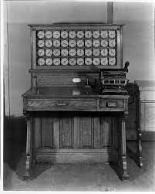
History of Computational Programming
Herman Hollerith’s (1819) Electro Mechanical Tabulating Machine featured Punch Cards. Hollerith’s machine was roughly 10x faster than manual tabulations, and completed the Census in just two and a half years - saving the census office millions of dollars. Businesses saw the value in boosting profit and improving labor intensive tasks by using the machine for data entry in accounting, insurance appraisals and inventory. Hollerith founded the Tabulating Machine Company that merged with other tabulating machine companies to become IBM(International Business Machine Co.)

Slide 7
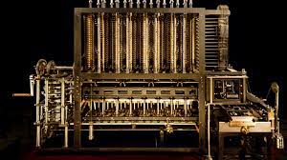
History and Innovations of the Calculator
The Difference Engine was one of Charles Babbage’s inventions not completed until 1991 by historians. Which proved to work approximated polynomials. Polynomials describe the relationship between several variables, Polynomials used to approximate logarithms and trigonometric functions.

Slide 8
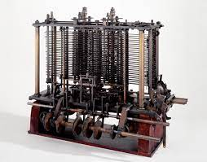
History and Innovations of the Calculator
During the building of The Difference Engine Babbage conceived of The Analytical Engine. Unlike the difference Engine, Step Reckoner and all other computational devices before it - the Analytical Engine was a “general purpose computer”.
Could used for more than just one particular computation also had memory and a primitive printer.
“At each increase of knowledge, as well as on the contrivance of every new tool, human labour becomes abridged.”
Charles Babbage(1827.)

Slide 9
History of Computational Programming
The foreshadowing of computer programming, Ada Lovelace a mathematician and first programmer wrote hypothetical programs for the Analytical Engine.
“A new, a vast, and a powerful Language is developed for the future use of analysis. ”
Ada Lovelace(1842)
Babbage inspired the first generation of computer scientists and was considered the Father of computing. At the end of the 19th century special use in Sciences and engineering. Not seen in business and government until.1818.

Slide 10
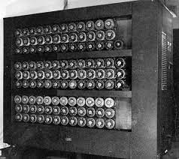
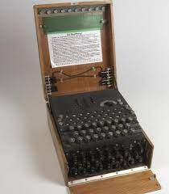
History and Innovations of the Calculator
The Enigma Machine aka the Bombe (1941) Alan Turing Cipher cracking machine.

Slide 11
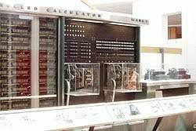
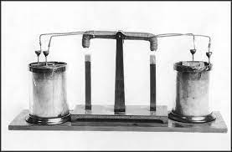
History and Innovations of the Calculator
The 1940’s was the era of Room Scale Computers Starting with the Harvard Mark I (1939-1944). This Relay driven machine ran simulations for the Manhattan Project. Innovation was the Relay(1940) Relay lifespan 10yrs wear and tear and higher probability of failure the more relays are in the circuit. The mechanical arm inside of the relay has mass, and therefore cannot move instantly between open and close states
Joseph Henry

Slide 12
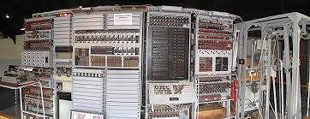
History and Innovations of the Calculator
The Colossus MK 1 (1943). Tommy Flower's machine used The Vacuum Tube. 10 Colossus were built to break codes using a plug board like telephone switchboard to program.

Slide 13
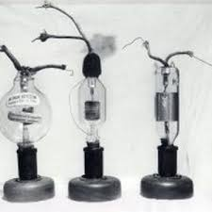
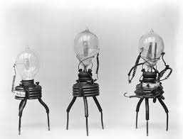
History and Innovations of the Calculator
Thermionic Valve or Vacuum Tube(1904)
Triode Vacuum Tube(1906)
John Ambrose Fleming
Lee DeForest
Moving closer to the modern age earlier inventions such as Relay and Vacuum Tube design lead to newer innovations of Diodes, Transistors, and the ICs.

Slide 14
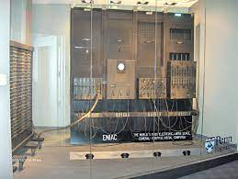
History and Innovations of the Calculator
The ENIAC (1945) Electronic Numerical Integrator and Calculator Designed by John Mauckly and J, Presper Eckert. ENAIC was a general purpose programmable Electronic computer

Slide 15
History and Innovations of the Calculator
In 1947 Bell Laboratory’s William Shockley, Walter Houser Brattain and John Bardeen invented the Transistor. An electronic switch is also called a solid state component. 1950 Vacuum Tube computing reached it Zenith. After 1960’s the shift form

Slide 16
History and Innovations of the Calculator
Miniaturization of Calculators in Japan
Sharp VS Casio
Thin Film Technology
Solar Cells
Reduce Keypad Travel

Slide 17
History and Innovations of the Calculator
ELTR-130 Data Logic
We can speak about the history of Calculators without mentioning Computer Science and Levels of Abstraction. In computers, an “on” state when electricity is flowing, represents true. The “off” state, no electricity flowing. Represents false. This is called Logic also referred to as Boolean Algebra. Named after George Boole Self Taught Mathematician in 1815. Boolean logic goes beyond Aristotle’s Logic. Boole’s approach allowed truth to be systematically and formally proven, through logic equations which he introduced in his first book,”The Mathematical Analysis of Logic”.

Slide 18
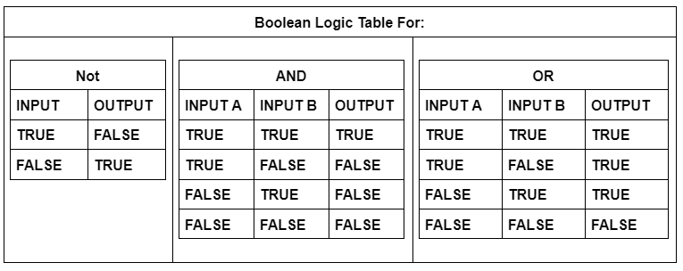
History and Innovations of the Calculator
ELTR-130 Data Logic

Slide 19
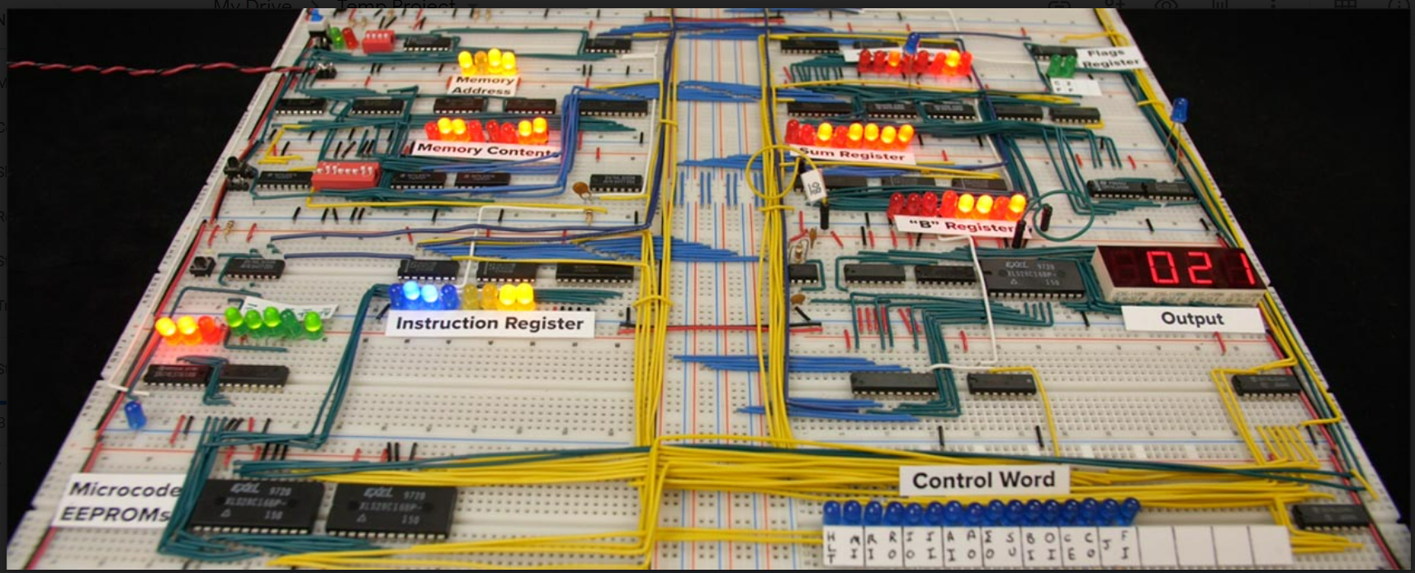
Ben Eater’s 8 Bit Computer
(2016)

Slide 20
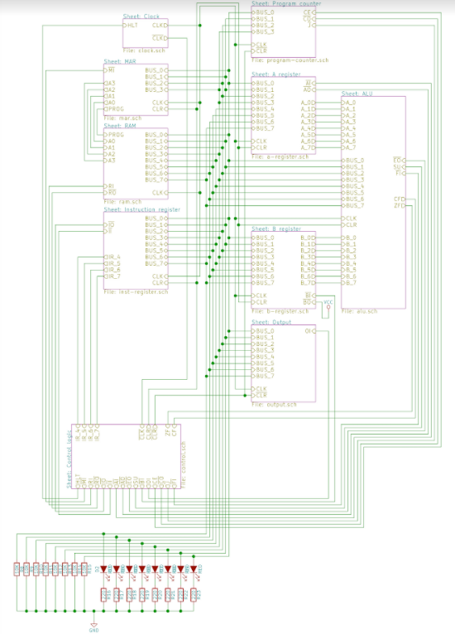
Ben Eater’s 8 Bit Computer
Module 1 The System Clock
Module 2
Registers
A register
B register
Instruction Register
Arithmetic unit (ALU)
Module 3
Memory Address Register (MAR)
Random access memory (RAM)
Program counter
Step Counter
Timing Interval
Module 4
CPU control logic
Output Register (Display 7 Segment)
The Bus communication
Flag Register (Carry bit, Zero)
Module 5 AC adapter for development of project and safety.
Master Sheet

Slide 21




XSC3
Tektronix
P 1 2 3 4 T G
0
U1
4
+
-
0.000
A
^{V1} 2
2
D2
1
DC 10M
0
T1
25 Vrms
4
1
60 Hz
0°
0
3
3
MDA2500
R1
C1 6.8mF
62 Ω
0
5
XMM1
0
U2 LM7812CT
LINE VREG VOLTAGE
COMMON
0
C2
C3 100nF
Power Supply Module 5
330nF
0
0
0
7

Slide 22
Ben Eater’s 8 Bit Computer
Astable
Clock
Mono Stable
Bi Stable
Prototype 2

Slide 23
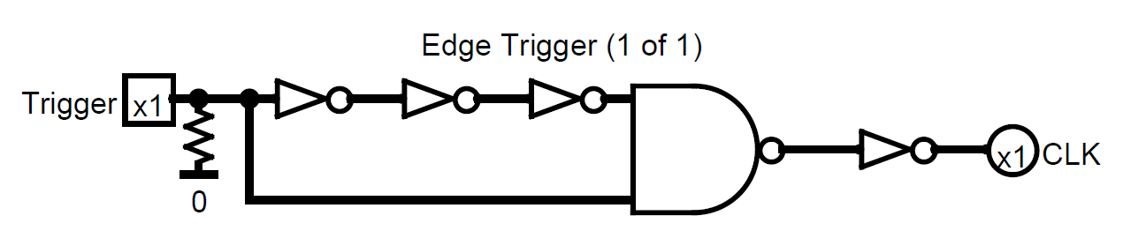
Ben Eater’s 8 Bit Computer
Edge Trigger Detection

Slide 24
Ben Eater’s 8 Bit Computer
MAR and RAM
Bus
Instruction Register
Clock
Program Counter
Registers A&B and ALU
Output and Control Logic

Slide 25
Ben Eater’s 8 Bit Computer
Register A
ALU
Sum Out
Register B
ADD and Subtraction Operations
Notes:
Register Logisim File: C:\Users\Thomas\Desktop\Logisim\8 bit Register.circ
ALU Logisim File: C:\Users\Thomas\Desktop\Logisim\1_Bit_ALU.circ

Slide 26
Ben Eater’s 8 Bit Computer
ELTR-130 Data logic
How Do Binary Values ADD?
00011100
00001110
28
14
42
00101010

Slide 27
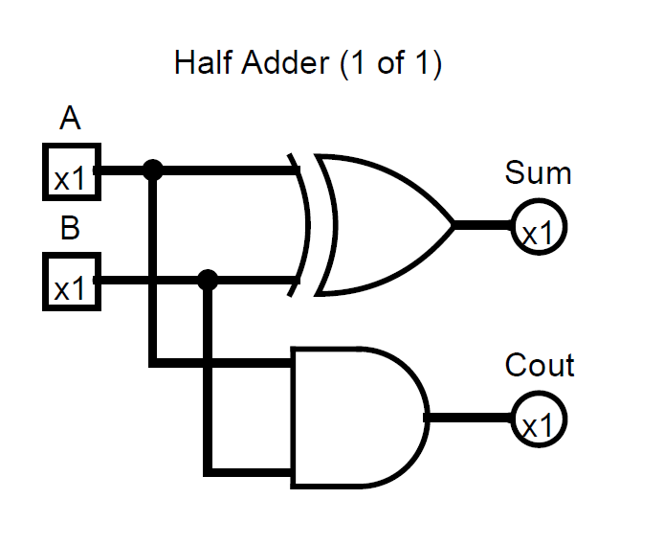
Ben Eater’s 8 Bit Computer

Slide 28
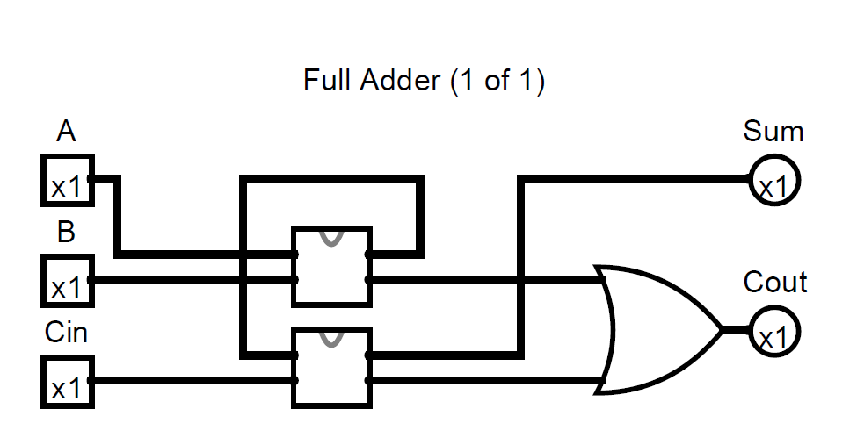
Ben Eater’s 8 Bit Computer

Slide 29
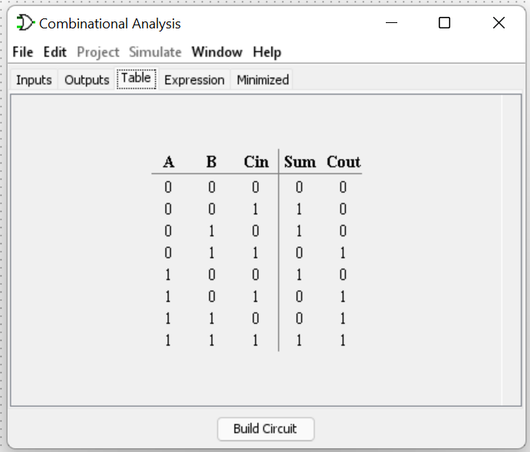
Ben Eater’s 8 Bit Computer

Slide 30
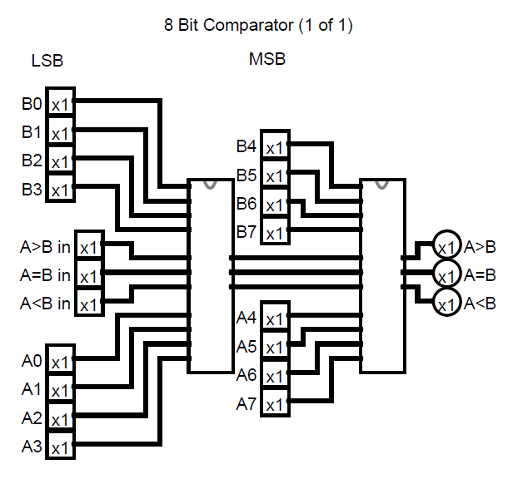
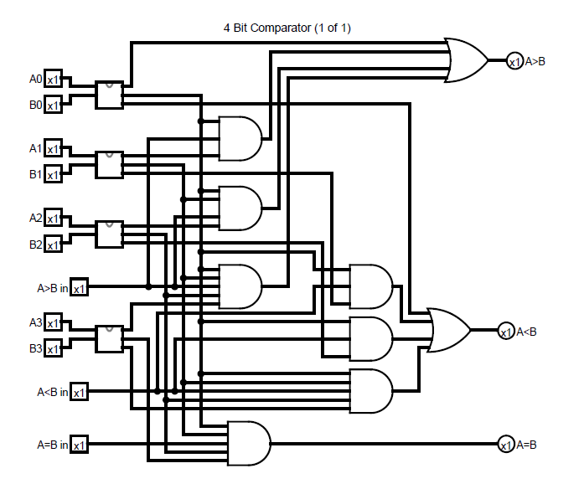
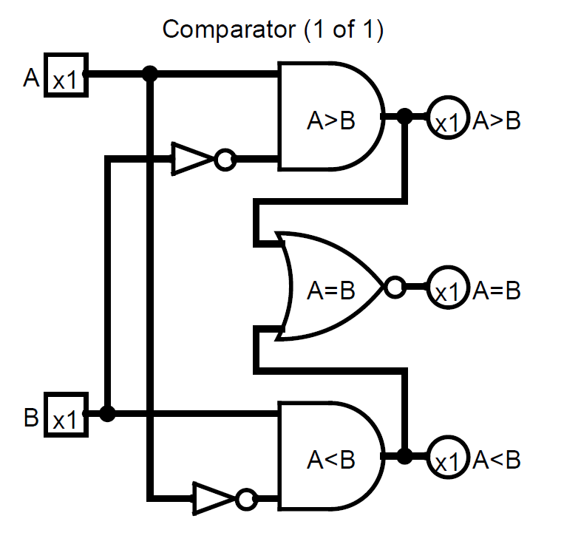
Ben Eater’s 8 Bit Computer

Slide 31
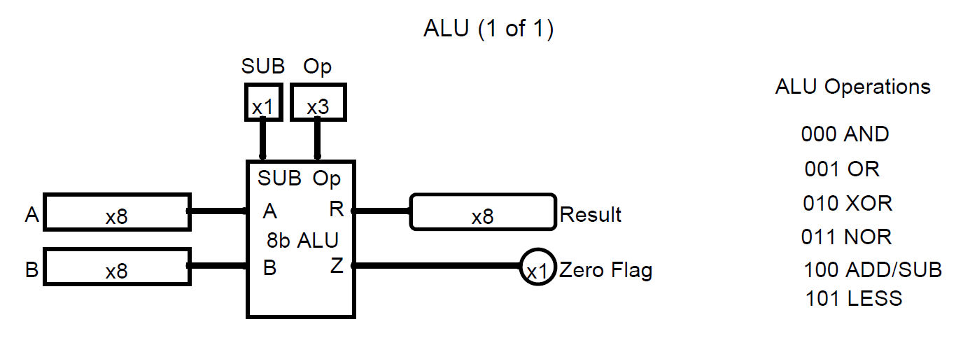
Ben Eater’s 8 Bit Computer
Logisim ALU
RUN Here.

Slide 32
Ben Eater’s 8 Bit Computer
ADD | A and B are summed
ADD with CARRY | A and B and a Carry-In bit are all summed
SUBTRACT | B is subtracted from A (or vice versa)
SUBTRACT with BORROW | B is subtracted from A (or vice versa) with borrow (carry-in)
NEGATE | A is subtracted from zero, flipping its sign (from - to +, or + to -)
INCREMENT | Add 1 to A
DECREMENT | Subtract 1 from A
PASS THROUGH | All bits of A are passed through unmodified
8 Operations Circuits:

Slide 33
Ben Eater’s 8 Bit Computer
Program Counter
MAR
Clock
RAM
Instruction
Memory, Address Instructions
Run Mode And Program Mode
Notes:
This clock Breadboard Circuit was made on TinkerCad

Slide 34
Ben Eater’s 8 Bit Computer
Write to memory
Read from memory
Registers ia a group of latches, which holds a single number, and the number of bits in a register is called its width.
RAM or Random Access Memory
Persistent Memory

Slide 35
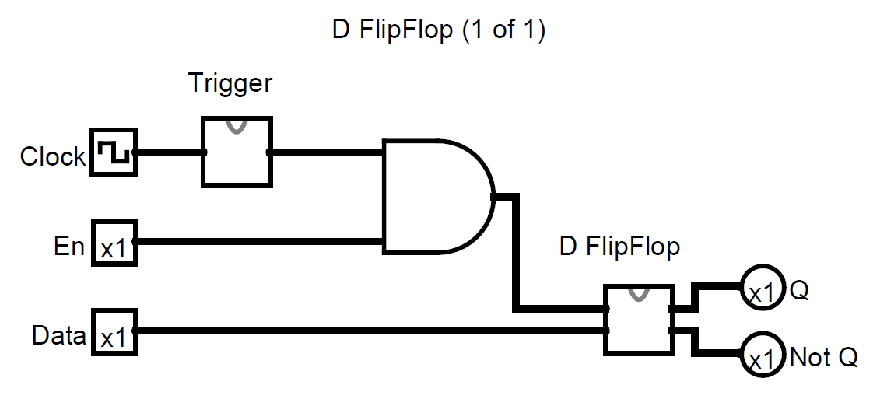
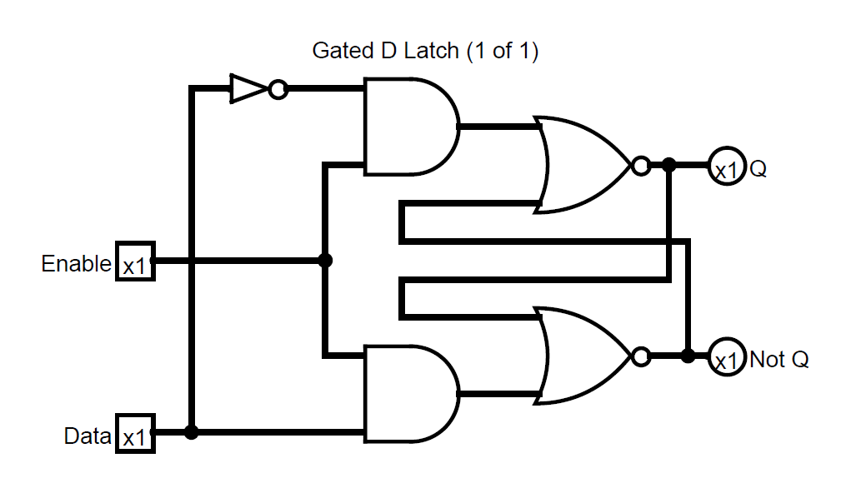
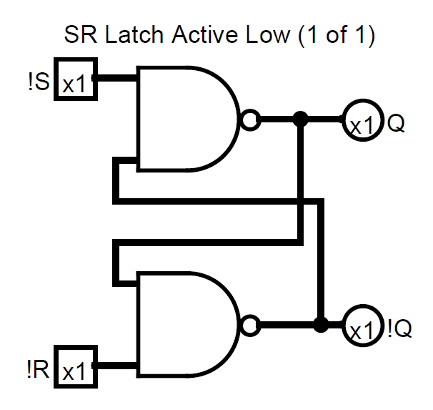
Ben Eater’s 8 Bit Computer
Latches and Memory

Slide 36
Ben Eater’s 8 Bit Computer
Clock
Instruction Register
NOT Clock
Control Logic
Output
Control Logic

Slide 37
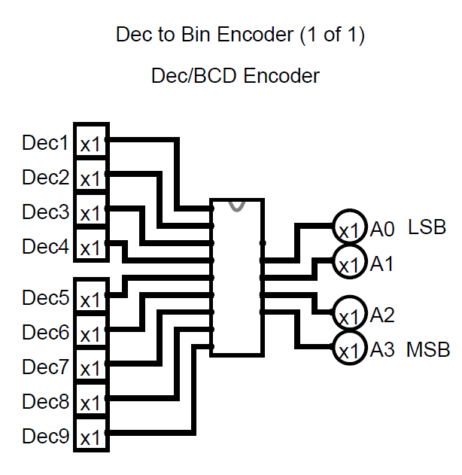
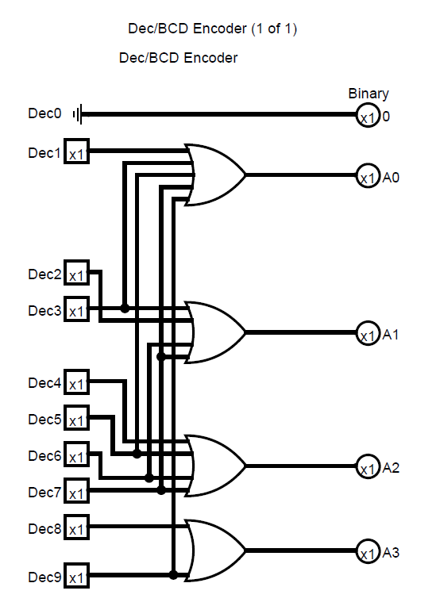
Ben Eater’s 8 Bit Computer

Slide 38
Ben Eater’s 8 Bit Computer
Binary To Decimal to 7 Segment Conversion

Slide 39
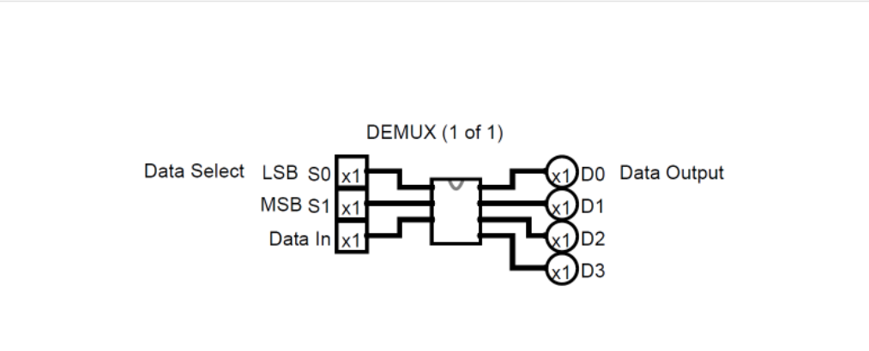
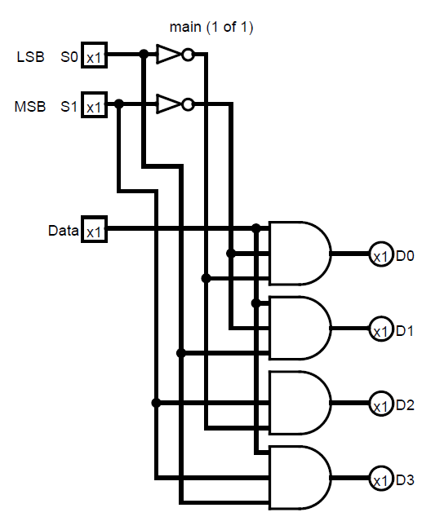
Ben Eater’s 8 Bit Computer
DeMUX

Slide 40
CENTRAL PROCESSING UNIT(CPU)
RAM
DATA
ADDRESS
DATA
REGISTER A
REGISTER B
0000
00011110
00000000
00000000
0001
00101111
0010
11100000
0011
00000000
CONTROL
UNIT
INSTRUCTION REGISTER
0100
00000000
INPUT
INPUT
0000
0000
0101
00000000
ALU
(OP(CODE))
0110
00000000
OPERATION
CODE
ADDRESS INPUT
0111
00000000
00000000
1000
00000000
O
Z
N
INSTRUCTION REGISTER
counter
FLAG
1001
00000000
1010
00000000
OUTPUT
READ ENABLE
1011
00000000
CLOCK
1100
00000000
WRITE ENABLE
1101
00000000
1110
00011100
1111
00001110

Slide 41
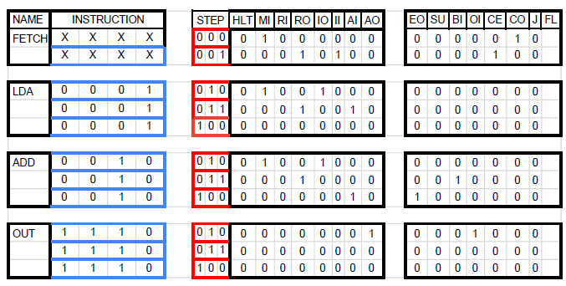
Ben Eater’s 8 Bit Computer
Instructions
Control Logic and Programing

Slide 42
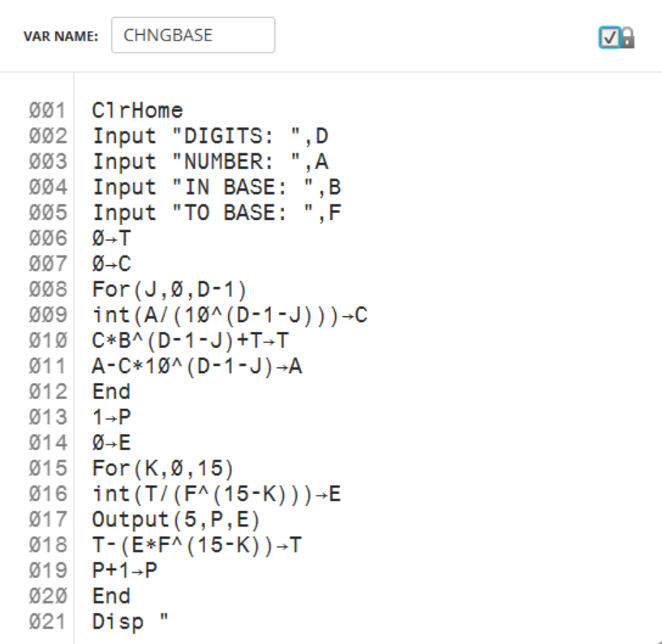

Slide 43
Ben Eater’s 8 Bit Computer
Testing and TroubleShooting
Testing:
Run a Functional Module Check. You may Need to hookup the required INPUTS and OUTPUTS to see if the Module is operational.
Running the subsystem checks before networking them together or through the BUS will help isolate for troubleshooting.
ADD another module Test operations if good then add one more and Test. Do this until they Master System is completed.
TroubleShooting:
Problem
Clock has an inverter OUTPUT and only lights if the LED is place in circuit with Cathode to pin 8 of the 74LS08 AND Gate and Anode to VCC.
Solution
Maksure the ICs have VCC and Ground connected
Power distribution Problems
Why does an LED light when the INPUT is 0?
Solution
Trace signal on bus by remove each modules connection on by one until you find the one.
Sometimes damaged ICS will send random signals,

Slide 44
APA Citation
Eater, B. (n.d.). 8 Bit Computer. Eater.Net. https://eater.net/8bit
8 bit-computer.jpeg image
X,B.(n.d). Using the 555 Timer. DroneBot Workshop.https://dronebotworkshop.com/555-timer/
Miscellaneous image
Eater,B. [Ben Eater]. (Year, Month Day). Clock logic - 8-bit computer clock - part 4 [Video]. YouTube.
https://www.youtube.com/watch?v=SmQ5K7UQPMM
Anne,C. [ Crash Course]. (Year, Month Day). Crash Course- The Central Processing Unit (CPU) Crash Course Computer Science #7 [Video]. YouTube.
https://www.youtube.com/watch?v=FZGugFqdr60&t=548s
RE Make CPU SLIDE for Demo

Slide 45
Ben Eater 8 Bit Computer
USER MANUAL
All projects should include a user manual that will explain how your electronic system works from the
perspective of the end user. This can include relevant illustrations, instructions and safety information.
Your instructor is likely to try operating your finished product using your user manual and make an
evaluation on that basis.

Slide 46
Ben Eater’s 8 Bit Computer
THEORY REQUIREMENTS
ELTR 100 – Electrical Network Analysis
This might include the use of discrete passive components such as resistors, capacitors, inductors, potentiometers, and/or specific component configurations such as voltage dividers, current dividers, filters, time-constant delays, and/or some combination thereof.
ELTR 130 – Digital Logic Systems
This might include the use of discrete basic logic ICs, discrete combinational logic ICs, memory devices, counters, timers, and/or some combination thereof.
ELTR 150 – Solid State Semiconductor Devices
This might include the use of discrete semiconductor components such as diodes or transistors, transistor amplifier circuits, operational amplifiers, and/or some
combination thereof.

Slide 47
Ben Eater 8 Bit Computer
Project Contents
MATERIAL REQUIREMENTS
Sketches and/or illustrations
Block diagrams
Schematic diagrams
Logic diagrams
Concept art
Journals
Graphs
Test results
Research materials
Anything else you think is relevant to your project

Slide 48
Ben Eater’s 8 Bit Computer
Check List
MATERIAL REQUIREMENTS
Design materials
Diagrams and schematics
Documentation and information
A functional prototype
A functional final product
An audio-visual presentation

